Slide 1
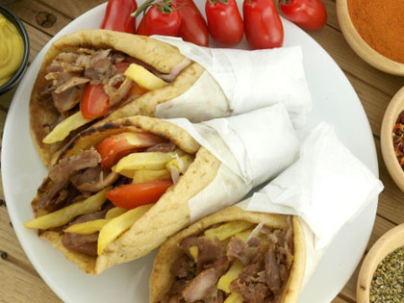




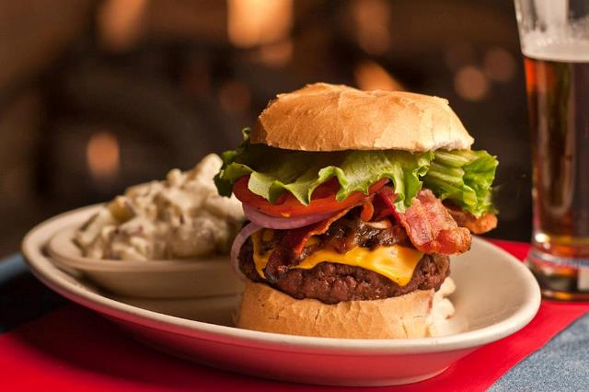
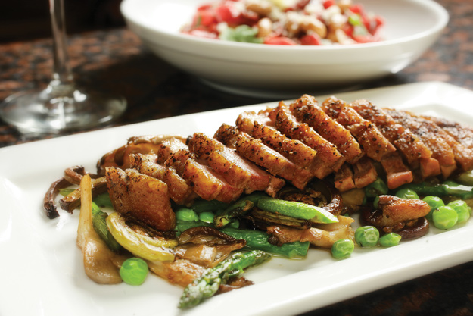
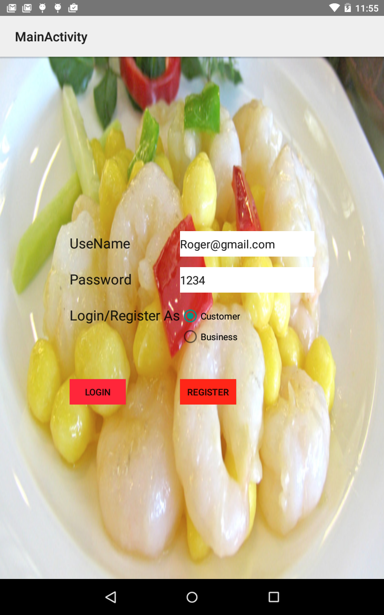
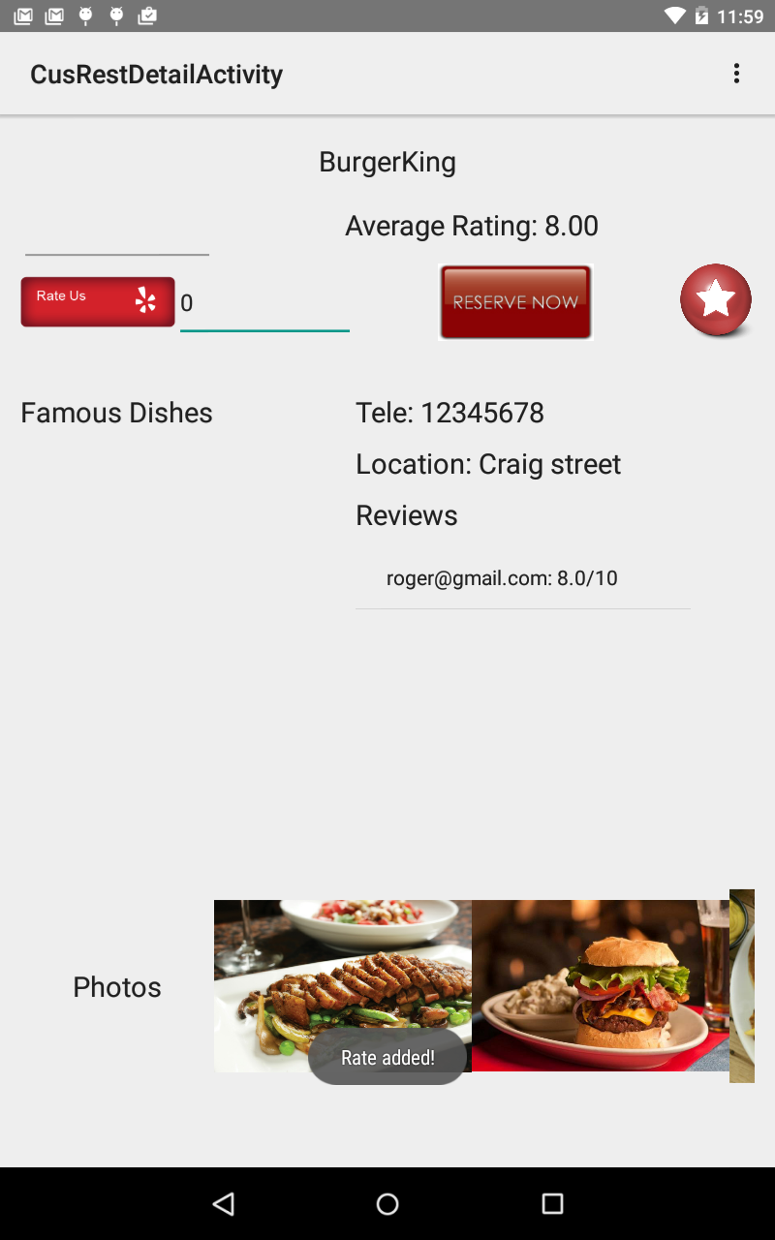


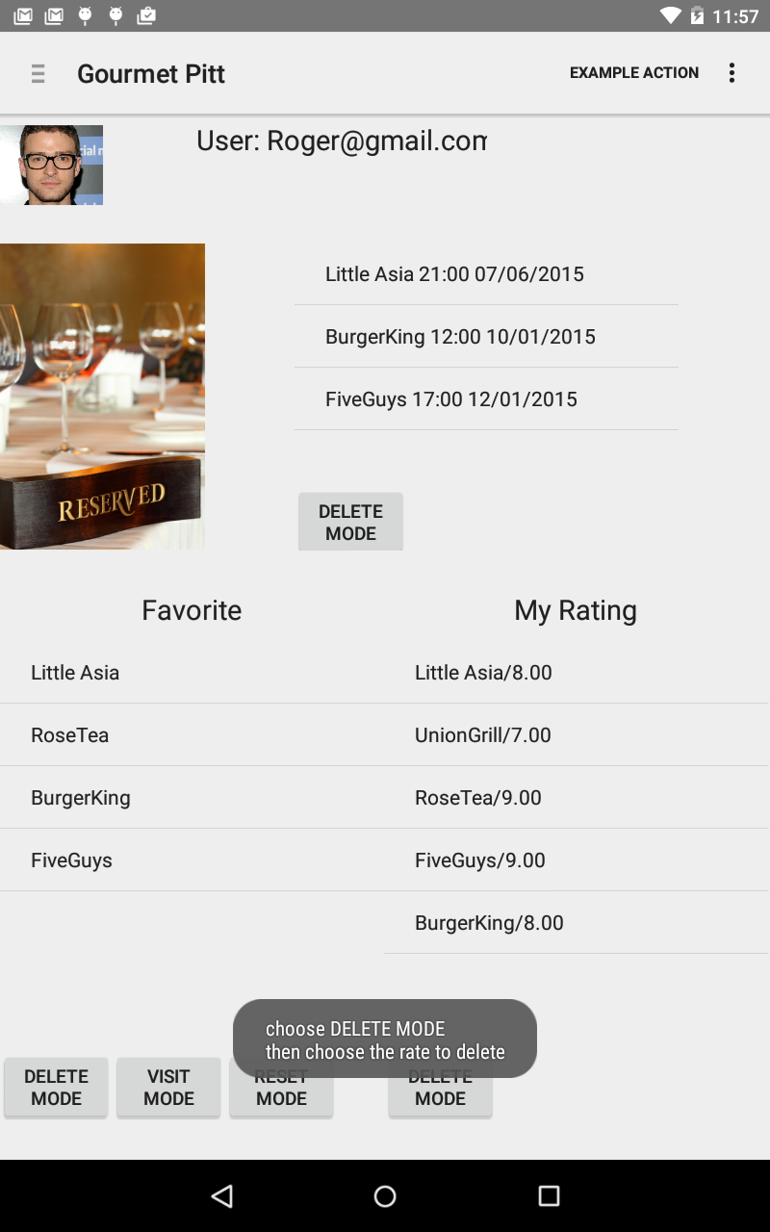
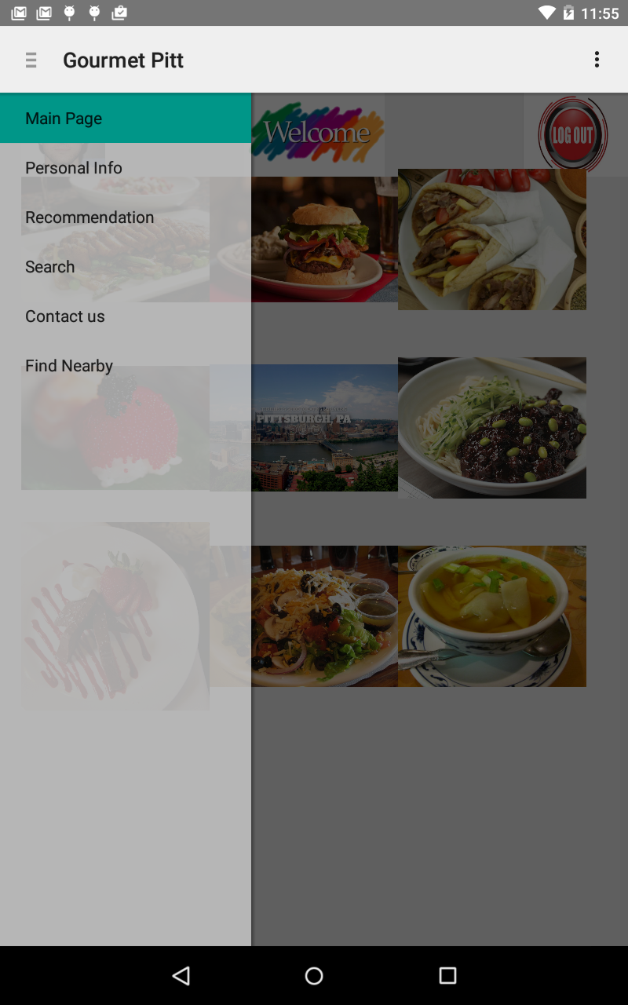








Gourmet Pitt Tour Haoran Yu, Mujing Zhou, Run Yang
The idea
What is already in App store
Yelp Dian Ping Evernote Food
What is new in our App
- Local-featured Recommendation
- Customized Flavor
- Customer-Oriented and Business-Oriented
- Find Nearby Restaurants
Challenges
Multithreaded Server/Client Communication: Synchronization
Database Design: Shared Rating/Review Table,
Instantly Updated Average Review
Google Map: Find Nearby Algorithm
AWS: Authority Setup, File Storage and Transmission
Background Service: Collaboration with Activity
Notable Features
Flavor Matching for Restaurant Recommendation
Customer Rating, Review and Reservation
Find Nearby Popular Restaurants using GPS
Take and Upload Photos
Background Music
Voice Recognition for Searching
Instant User Feedback

